Slide 1
PCA

Slide 2
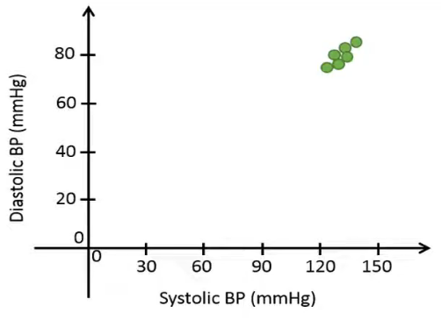
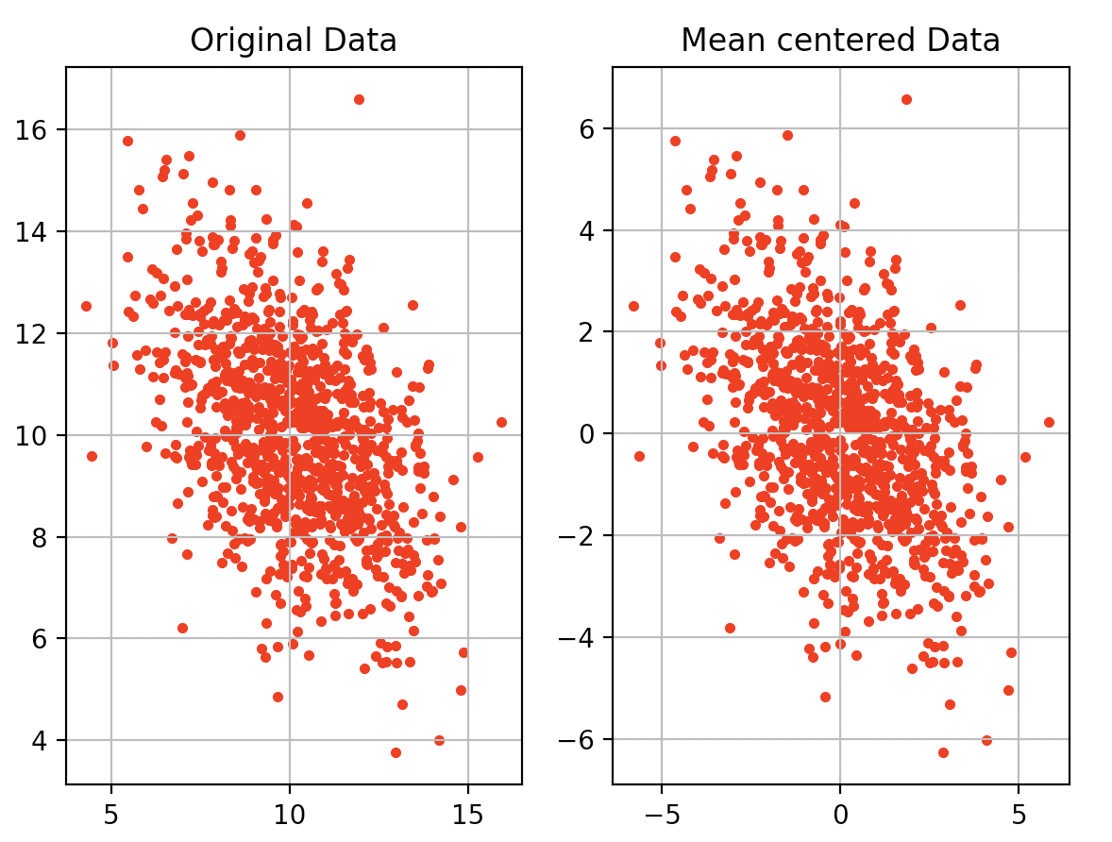
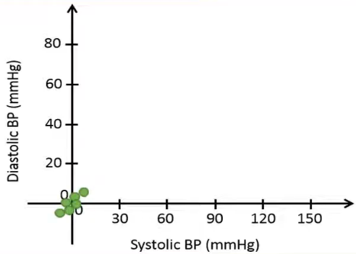
Principal Component Analysis
First thing first: What happens if you subtract mean from the data?

Slide 3
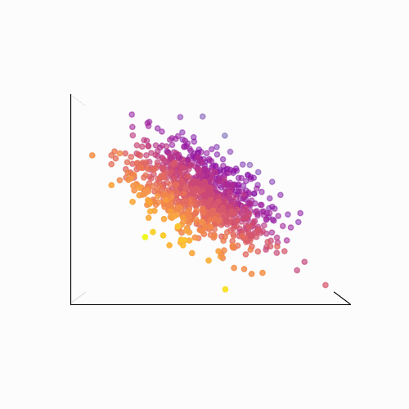
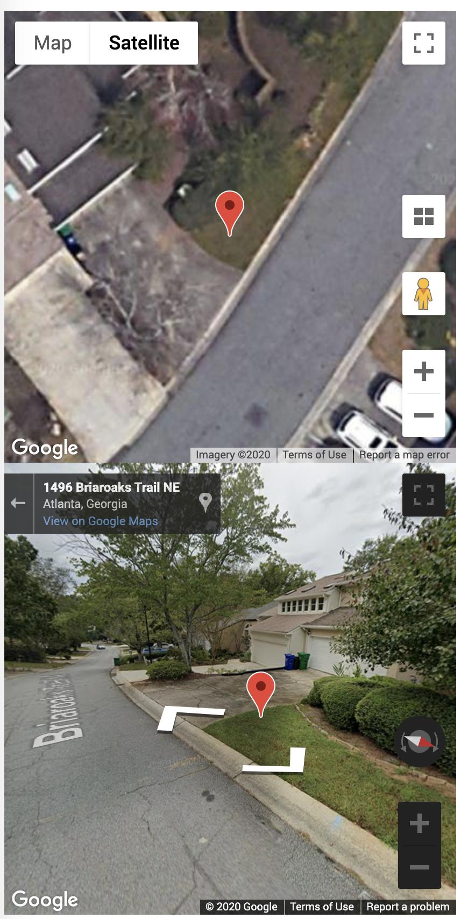
Principal Component Analysis
Second: What happens if we observe the data using different rotations?
Observation: Observing the data from different rotation gives you different amount of information!

Slide 4
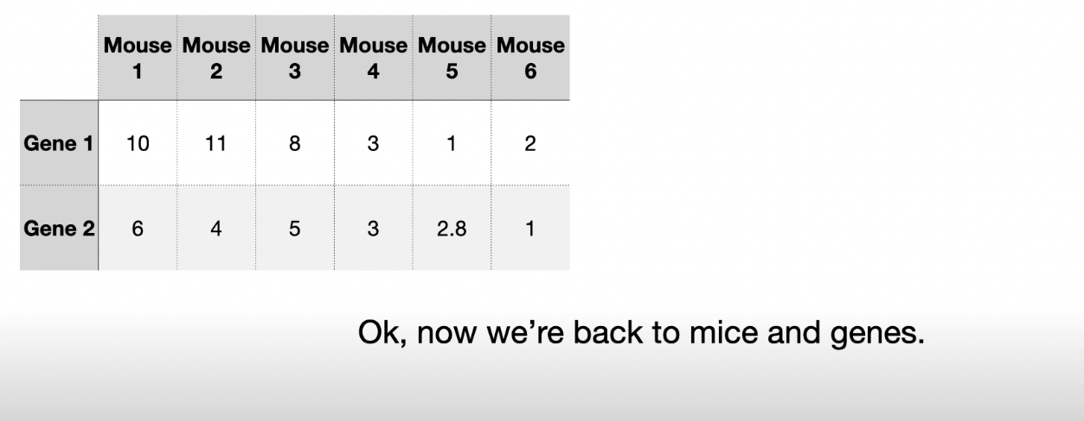

Slide 5
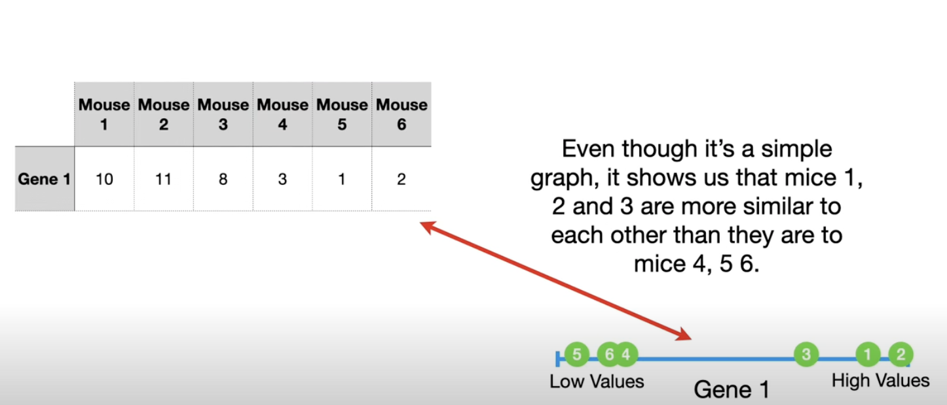

Slide 6
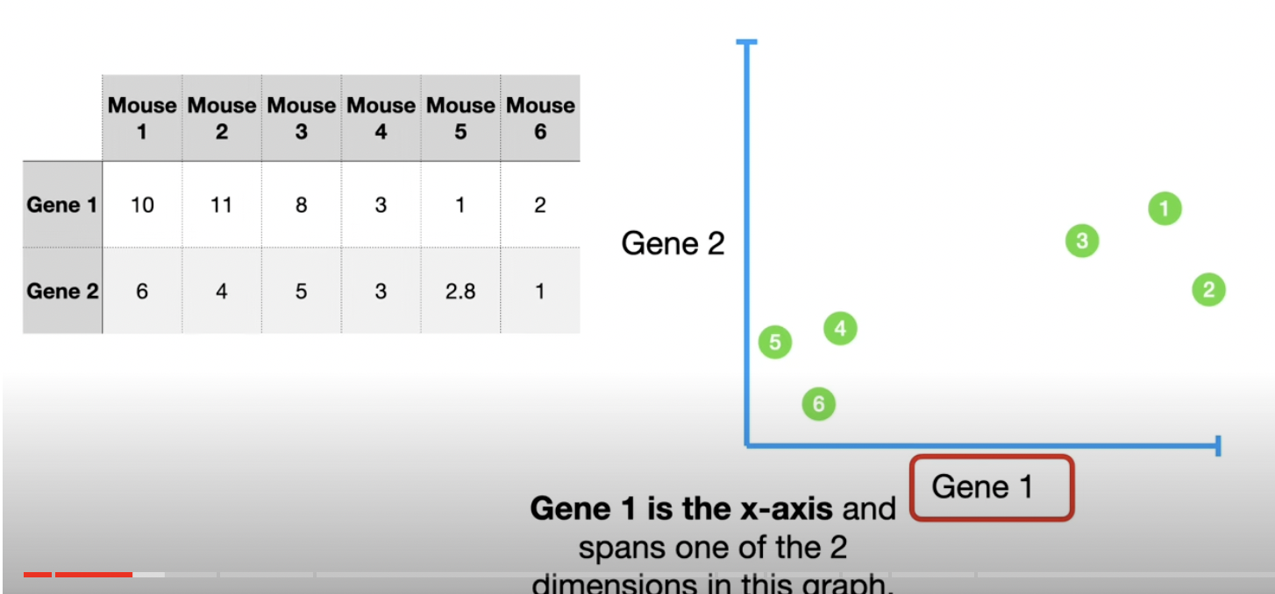

Slide 7
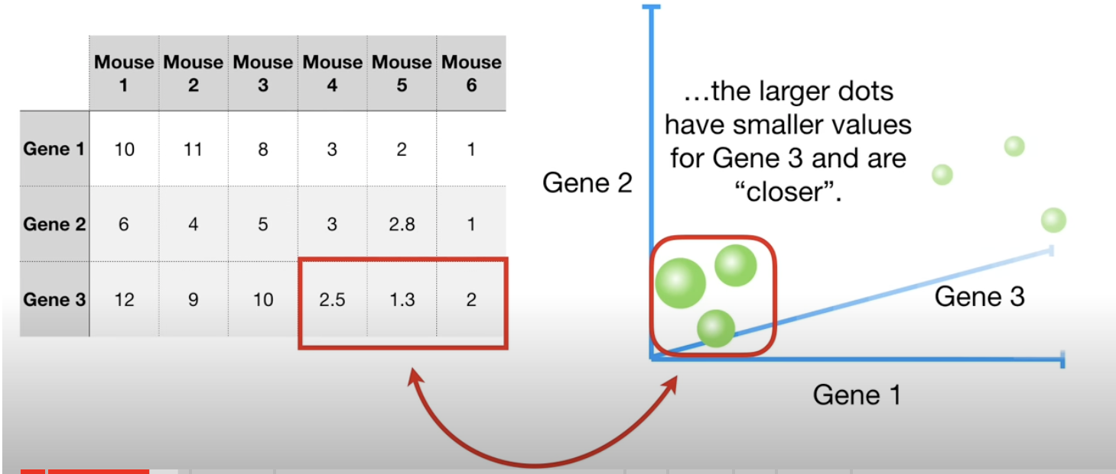

Slide 8
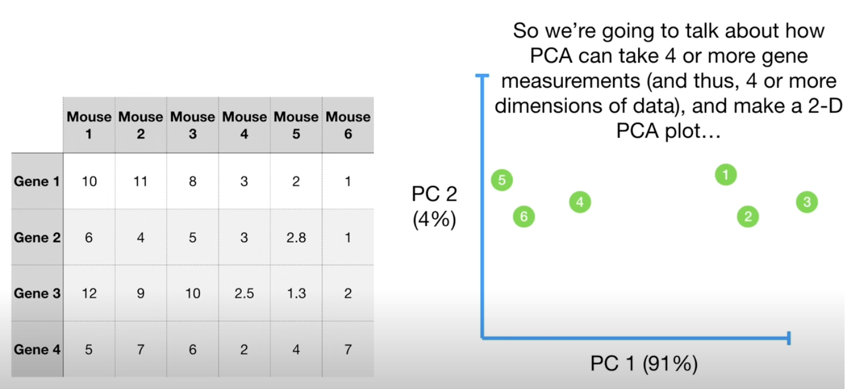

Slide 9
Why PCA ?
Principle Component Analysis (PCA) is a dimnesionalty reduction technique
PCA is used in exploratory data analysis and for making predictive models
Find a projection that captures the largest amount of variation in data
Features
1 | 2 | .. | .. | n
New Features m < n
Samples

Slide 10
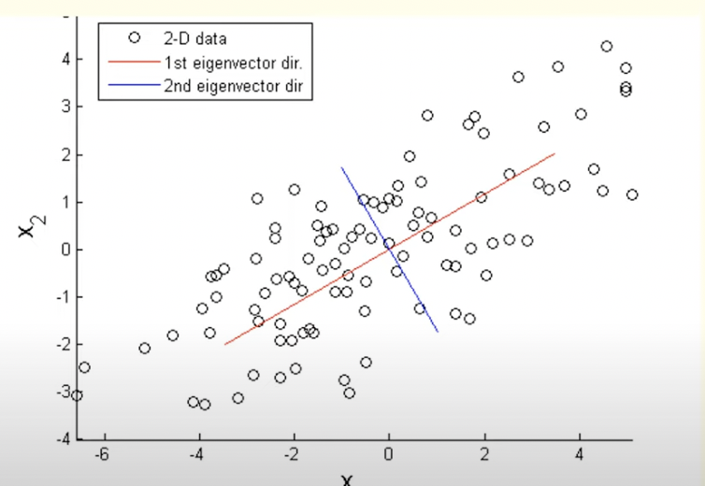
How To Reduce the dimensions ?
It is done by projecting each data point onto only the first few principle components to obtain lower-dimensional data while preserving as much of the data’s variation as possible.
Principle components are eigen vectors of the data’s covariance matrix
Notes:
These red and blue lines are my new axis and these new axis

Slide 11
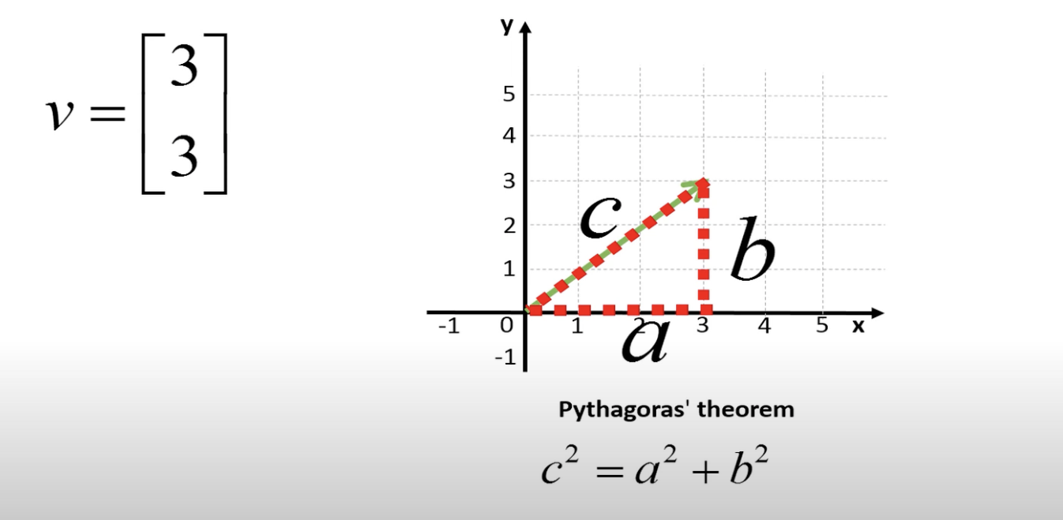
Vectors

Slide 12
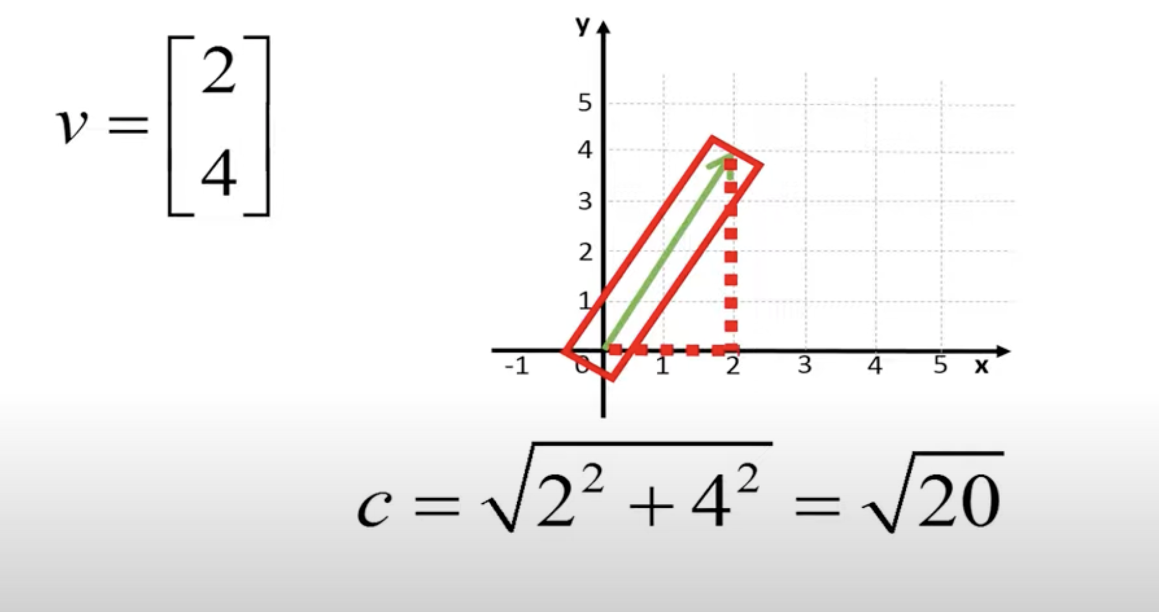
Vectors

Slide 13
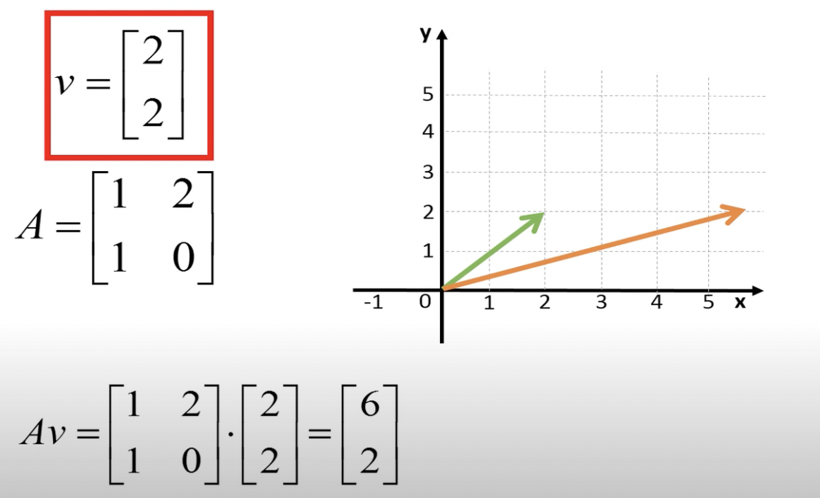
EigenVectors – Av = ⋋v
Notes:
Special vector eigen verctor is anon zero vector that satisfies the given equation.
If we multiply a square matrix A with a coloumn vector v and you get a new vector equals to a number lemda multplied by the old vector V then v is got a eigen vector of matrix A. One can think of this as if we multiply matrix A by vector v, the new vector does not the change the direction after transformation
This is not an eigen vector of matrix A as it changes the direction

Slide 14
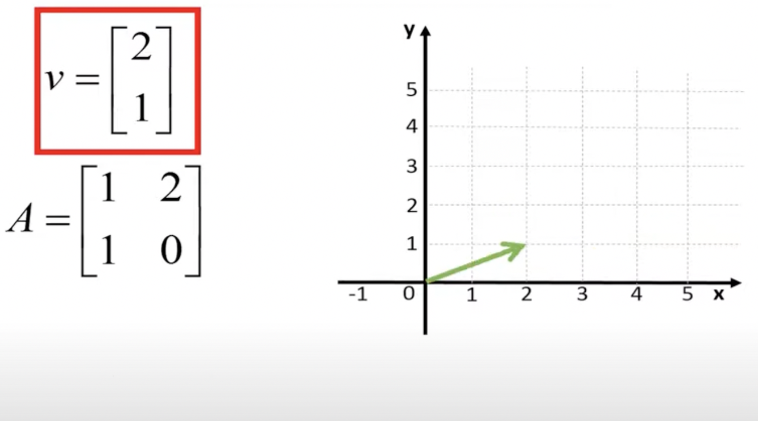
Check if its Eigen vector v of matrix A or not ?

Slide 15
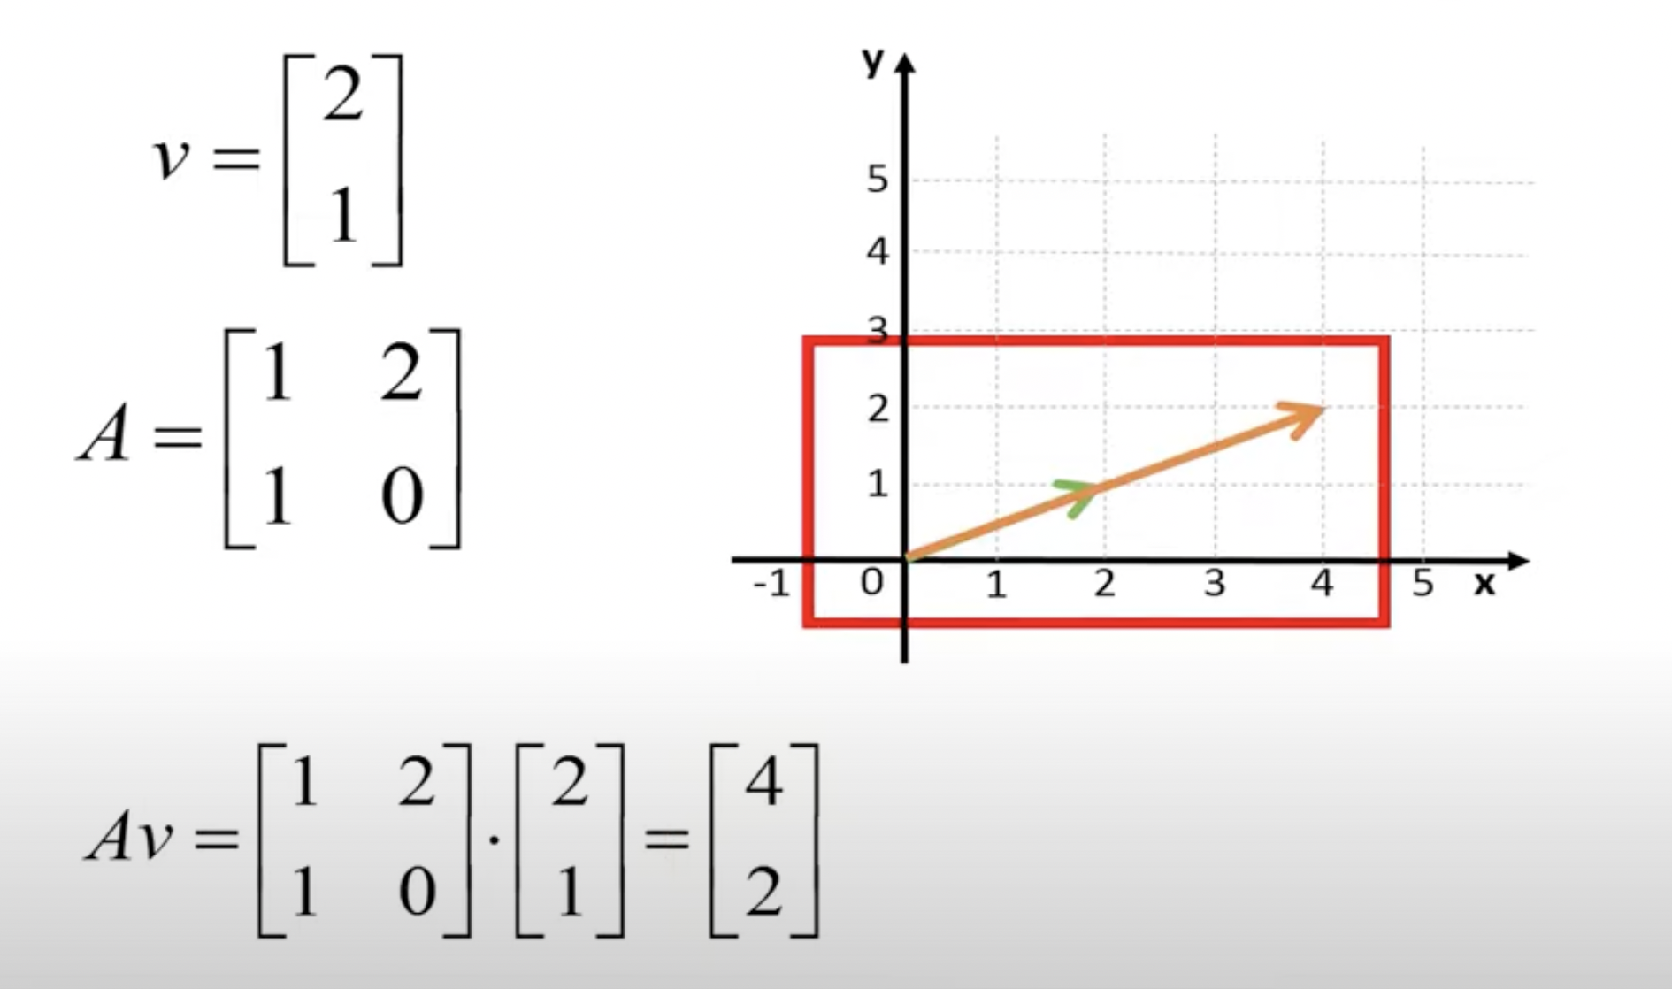
It is an eigen vector for matrix A
Notes:
It has same direction as original vector ☺

Slide 16
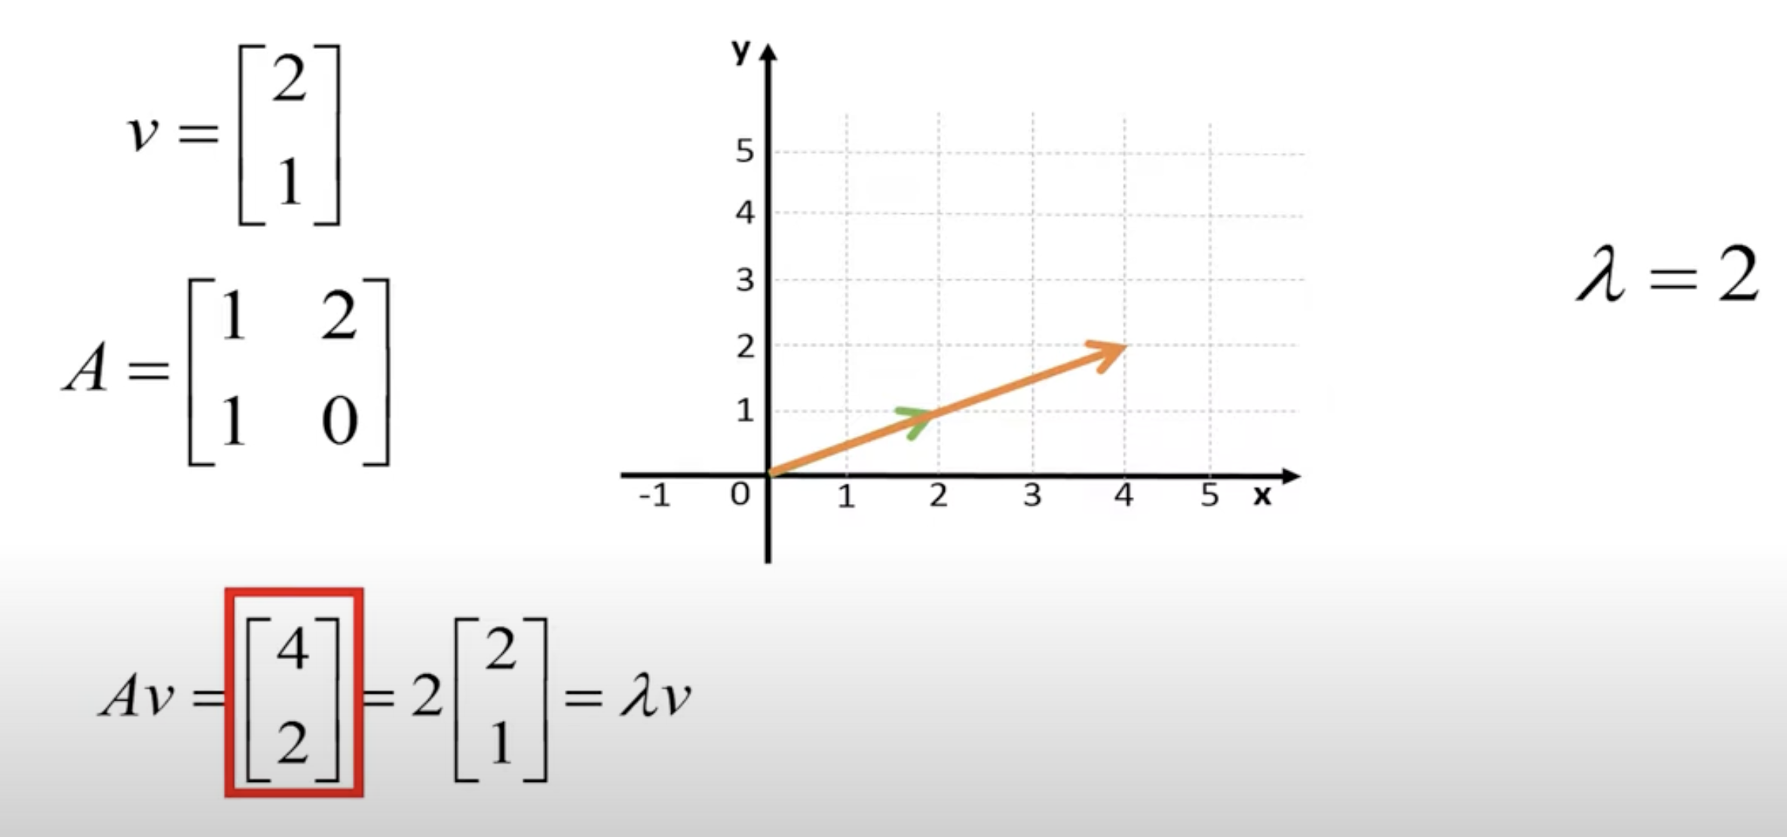
Eigen Value. ⋋
Notes:
We can conclude that eigen vector of matrix A can result in a new vector which has the same dierction as original vector. It might be shorter or longer to the original vector. This scaling factor is the corresponding eigen value.

Slide 17
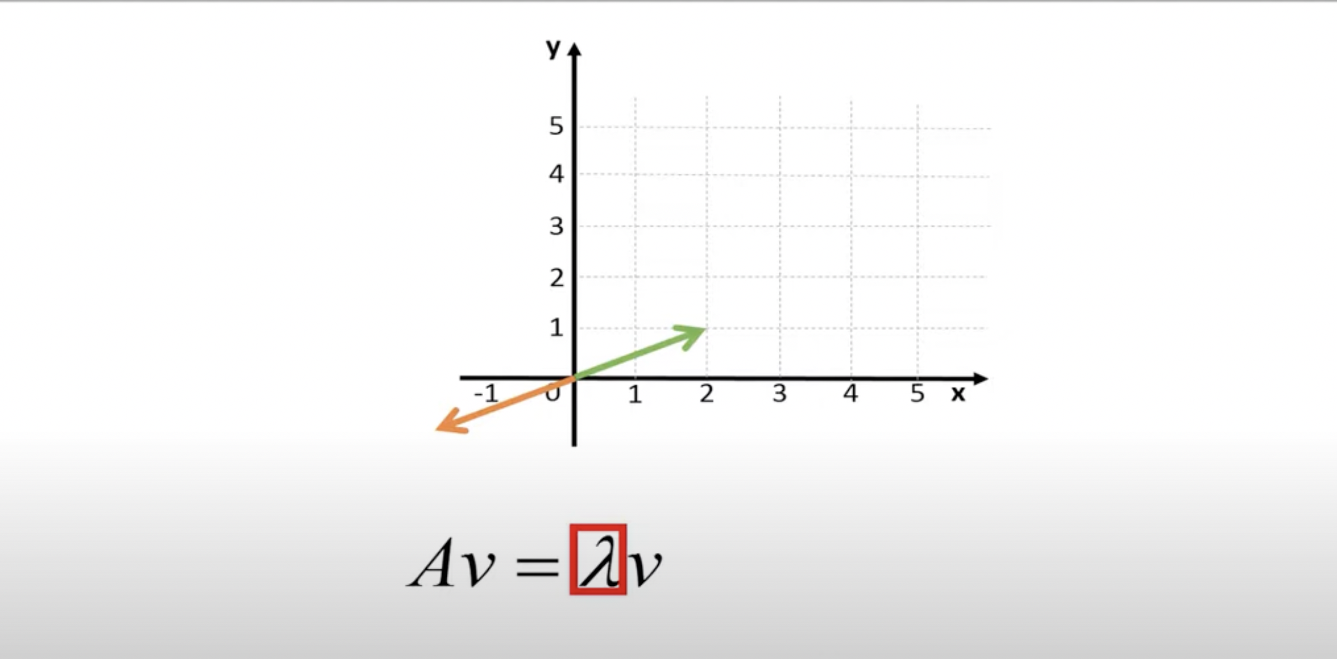
Eigen Value can be negavtive also
Notes:
eigen value here is -1

Slide 18
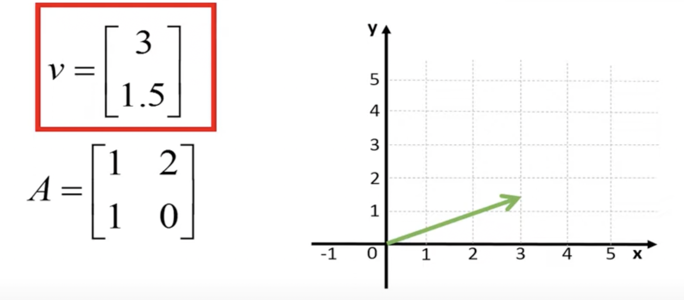
Is this an Eigen Vector ?

Slide 19
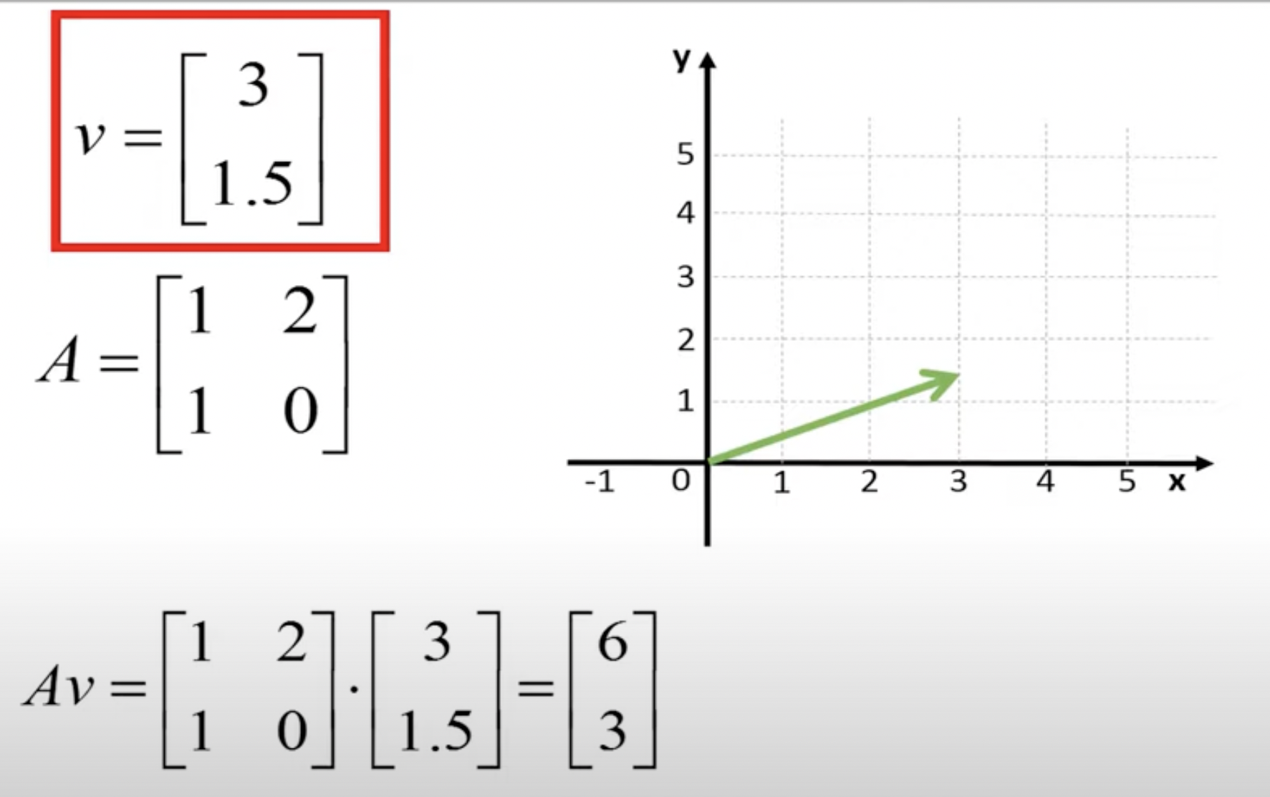
Yes It is !!!!!! whats the Eigen Value ???

Slide 20
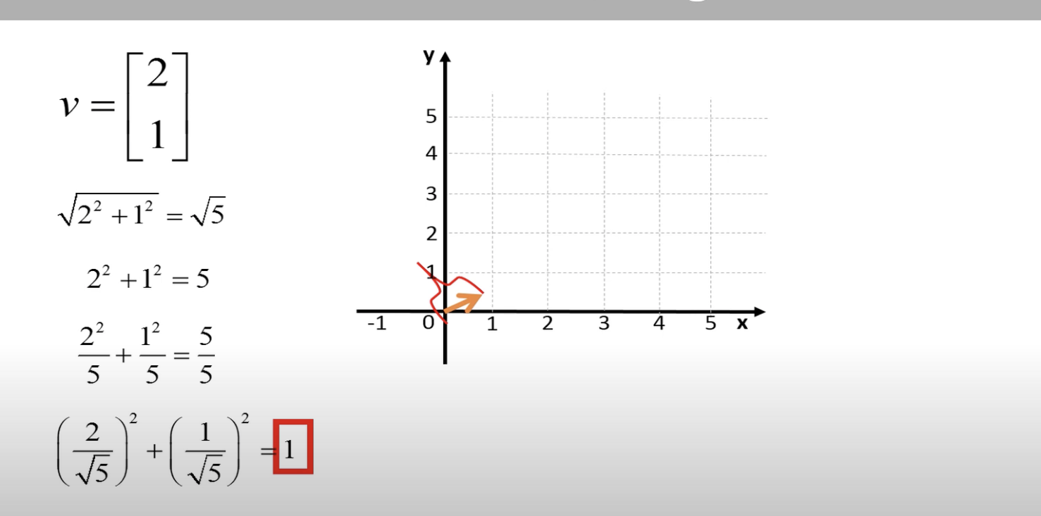
Normalizing Vector

Slide 21
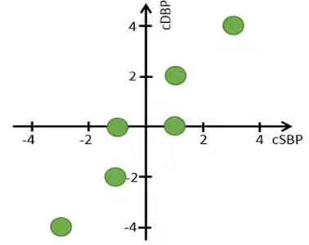
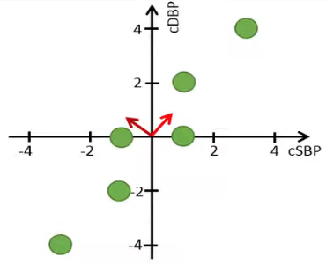
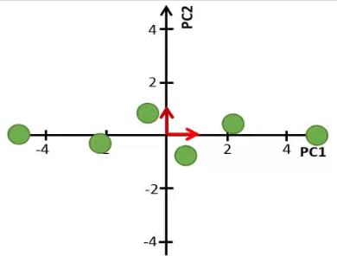
Principal Component Analysis
Try to increase variance but reduce covariance!! (i.e., make features independent via converting them to principal components)

Slide 22
Steps for dimensionality reduction using PCA
Standardize the data
Compute the covariance matrix
Calculate the eigenvectors and eigenvalues
Sort eigenvalues in descending order and compute the Principle Components
Reduce the dimensions of the dataset

Slide 23
Data Standardization
What ?
Why ?
How ?
Height (m) | Weights (pounds)

Slide 24

Step 1: How to standardize the data
Data Standardization is calculating a z-score or a standard score. It is given by
It gives an idea how far from the mean a data point is
$$Z= \frac{x−μ}{σ}$$

Slide 25
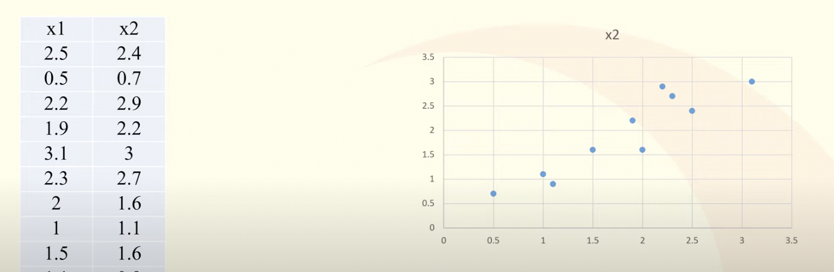
Example
Given 10 samples of two features x1 and x2 as:

Slide 26
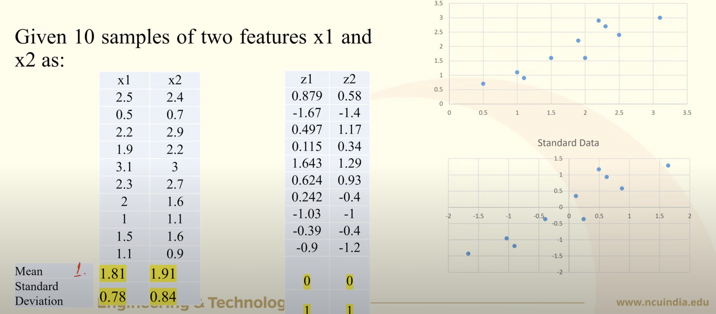
Example

Slide 27
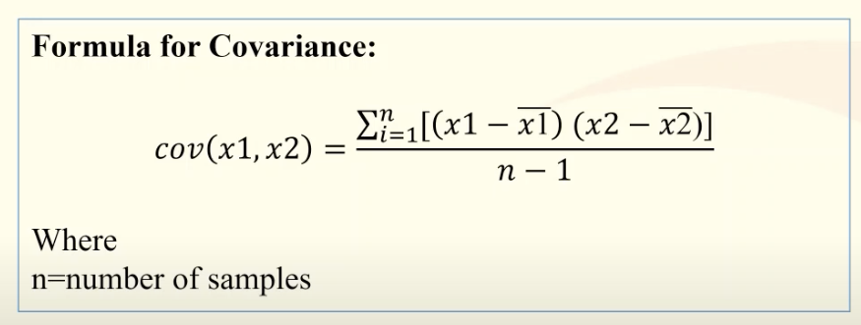
Step 2: Covmpute Covariance Matrix
Covariance is always measured between two variables or features
It measure only the directional relationship between two variables not the strength of the relationship between them.

Slide 28
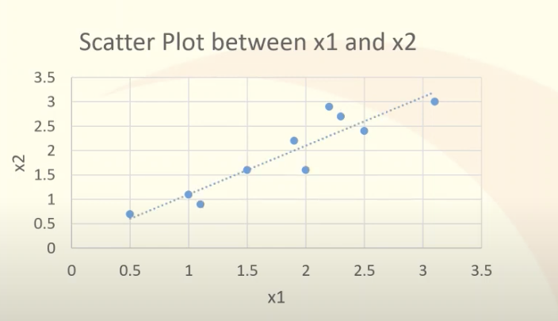
Example
Given 10 samples of two feastures x1 and x2 as:
X1 | X2
2.5 | 2.4
0.5 | 0.7
2.2 | 2.9
1.9 | 2.2
3.1 | 3
2.3 | 2.7
2 | 1.6
1 | 1.1
1.5 | 1.6
1,1 | 0.9

Slide 29
Example
Given 10 samples of two feastures x1 and x2 as:
X1 | X2
2.5 | 2.4
0.5 | 0.7
2.2 | 2.9
1.9 | 2.2
3.1 | 3
2.3 | 2.7
2 | 1.6
1 | 1.1
1.5 | 1.6
1,1 | 0.9

Slide 30
Example
Given 10 samples of two feastures x1 and x2 as:
X1 | X2
2.5 | 2.4
0.5 | 0.7
2.2 | 2.9
1.9 | 2.2
3.1 | 3
2.3 | 2.7
2 | 1.6
1 | 1.1
1.5 | 1.6
1,1 | 0.9
x1 – mean(x1) | x2 – mean(x2) | [x1-mean(x1)][x2-mean(x2)]

Slide 31
Example
Given 10 samples of two feastures x1 and x2 as:
X1 | X2
2.5 | 2.4
0.5 | 0.7
2.2 | 2.9
1.9 | 2.2
3.1 | 3
2.3 | 2.7
2 | 1.6
1 | 1.1
1.5 | 1.6
1.1 | 0.9
1.81 | 1.91
x1 – mean(x1) | x2 – mean(x2) | [x1-mean(x1)][x2-mean(x2)]
0.69 | 0.49 | 0.3381
-1.31 | -1.21 | 1.5851
0.39 | 0.99 | 0.3861
0.09 | 0.29 | 0.0261
1.29 | 1.09 | 1.4061
0.49 | 0.79 | 0.3871
0.19 | -0.31 | -0.0589
-0.81 | -0.81 | 0.6561
-0.31 | -0.31 | 0.0961
-0.71 | -1.01 | 0.7171
 |  | 0.61544444

Slide 32
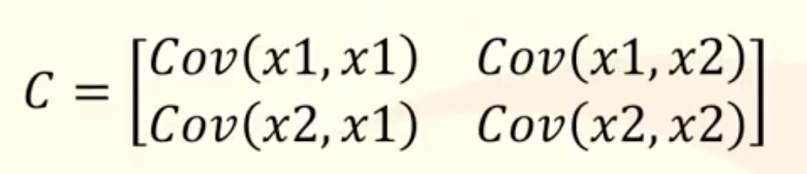
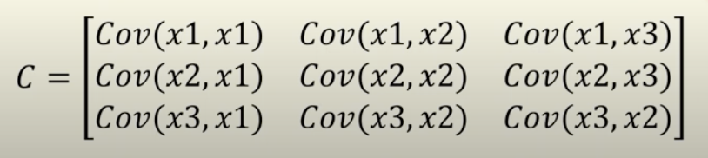
Example
For 2-feayures (x1,x2), the covariance matrix is as follow
For 3-features (x1,x2,x3), the covariance matrix would be

Slide 33
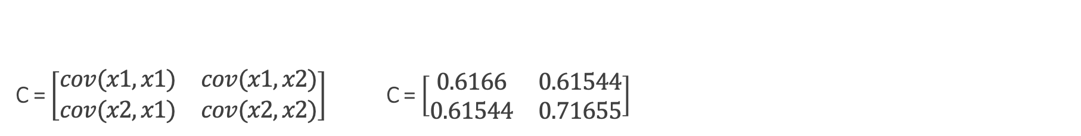
C = $\left[\begin{matrix}cov(x1,x1) & cov(x1,x2) \\ cov(x2,x1) & cov(x2,x2)\end{matrix}\right]$ C = $\left[\begin{matrix}0.6166 & 0.61544 \\ 0.61544 & 0.71655\end{matrix}\right]$
x1 – mean(x1) | x2 – mean(x2) | [x1-mean(x1)][x2-mean(x2)] | [x1 – mean(x1)]² | [x2 – mean(x2)]²
0.69 | 0.49 | 0.3381 | 0.4830 | 0.2401
-1.31 | -1.21 | 1.5851 | 1.7030 | 1.4641
0.39 | 0.99 | 0.3861 | 0.1560 | 0.9801
0.09 | 0.29 | 0.0261 | 0.0090 | 0.0841
1.29 | 1.09 | 1.4061 | 1.6770 | 1.1881
0.49 | 0.79 | 0.3871 | 0.2450 | 0.6241
0.19 | -0.31 | -0.0589 | 0.0380 | 0.0961
-0.81 | -0.81 | 0.6561 | 0.6480 | 0.6561
-0.31 | -0.31 | 0.0961 | 0.0930 | 0.0961
-0.71 | -1.01 | 0.7171 | 0.4970 | 1.0201
 |  | 0.61544444 | 0.6166 | 0.71655556
X1 | X2
2.5 | 2.4
0.5 | 0.7
2.2 | 2.9
1.9 | 2.2
3.1 | 3
2.3 | 2.7
2 | 1.6
1 | 1.1
1.5 | 1.6
1.1 | 0.9
1.81 | 1.91

Slide 34
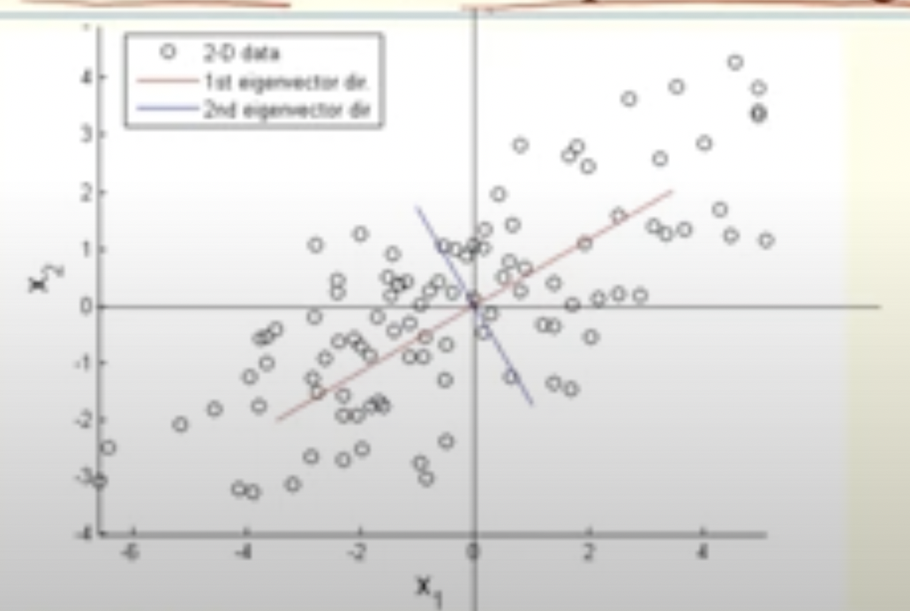
Step3: Calculate eigenvalues and eigenvectors
What are Eigenvalues and Eigenvectors?
Eigenvalues and Eigenvectors are the linear algebra concept that are required in the detrmination of principle component from the covariance matrix
Eigenvectors help in finding the new transformation where there is maximum variance
C v = ⋋ v
Eigenvectors, v are those vectors which keep the direction same when multiplied by a matrix C
Eigenvalues, ⋋ are the scalers of the respective eigenvectors

Slide 35
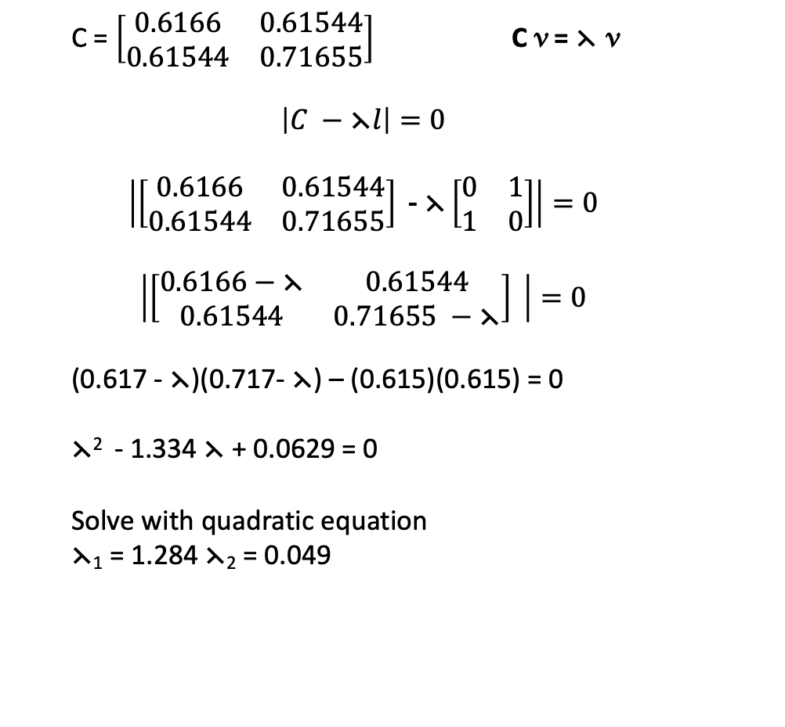
Example
X1 | X2
2.5 | 2.4
0.5 | 0.7
2.2 | 2.9
1.9 | 2.2
3.1 | 3
2.3 | 2.7
2 | 1.6
1 | 1.1
1.5 | 1.6
1,1 | 0.9
C = $\left[\begin{matrix}0.6166 & 0.61544 \\ 0.61544 & 0.71655\end{matrix}\right]$ C v = ⋋ v
$$\left|C −\text{⋋}l\right|=0$$
$$\left|\left[\begin{matrix}0.6166 & 0.61544 \\ 0.61544 & 0.71655\end{matrix}\right]\text{ − }\text{⋋}\left[\begin{matrix}0 & 1 \\ 1 & 0\end{matrix}\right]\right|=0$$
$$\left|\left[\begin{matrix}0.6166−\text{⋋} & 0.61544 \\ 0.61544 & 0.71655 −\text{⋋}\end{matrix}\right] \right|=0$$
(0.617 - $\text{⋋}$)(0.717- $\text{⋋}$) – (0.615)(0.615) = 0
$\text{⋋}$² - 1.334 $\text{⋋}$ + 0.0629 = 0
Solve with quadratic equation
$\text{⋋}$₁ = 1.284 $\text{⋋}\text{2}\text{ = 0.049}$

Slide 36
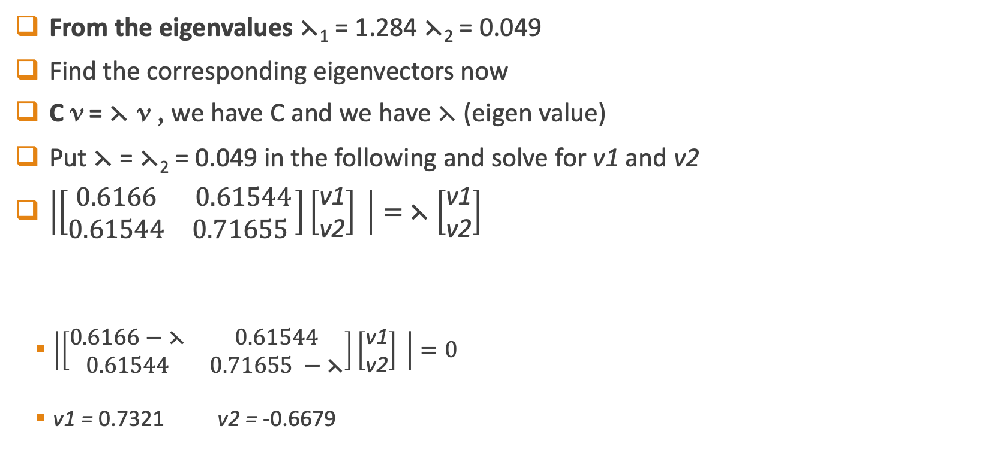
$\text{From} \text{the} \text{eigenvalues} \text{⋋}$₁ = 1.284 $\text{⋋}\text{2}\text{ = 0.049}$
Find the corresponding eigenvectors now
C v = ⋋ v , we have C and we have ⋋ (eigen value)
Put $\text{⋋}$ = $\text{⋋}\text{2}\text{ = 0.049}$ in the following and solve for v1 and v2
$\left|\left[\begin{matrix}0.6166 & 0.61544 \\ 0.61544 & 0.71655 \end{matrix}\right]\left[\begin{aligned}\text{v}\text{1} \\ \text{v}\text{2}\end{aligned}\right] \right|=$ ⋋ $\left[\begin{aligned}\text{v}\text{1} \\ \text{v}\text{2}\end{aligned}\right]$
$\left|\left[\begin{matrix}0.6166−\text{⋋} & 0.61544 \\ 0.61544 & 0.71655 −\text{⋋}\end{matrix}\right]\left[\begin{aligned}\text{v}\text{1} \\ \text{v}\text{2}\end{aligned}\right] \right|=0$
v1 = 0.7321 v2 = -0.6679

Slide 37
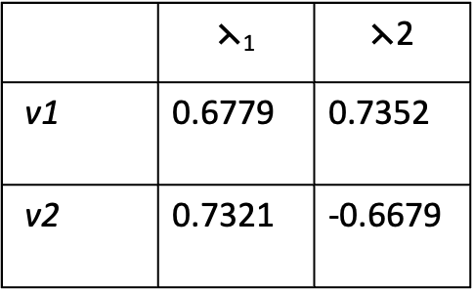
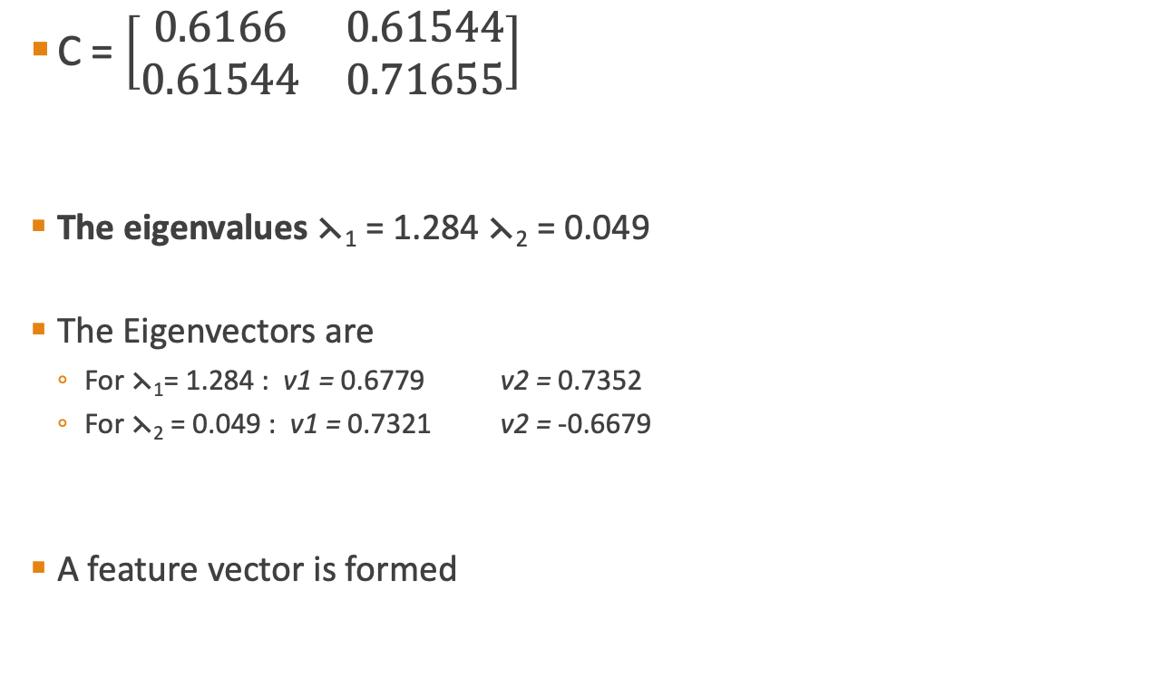
Summarize
X1 | X2
2.5 | 2.4
0.5 | 0.7
2.2 | 2.9
1.9 | 2.2
3.1 | 3
2.3 | 2.7
2 | 1.6
1 | 1.1
1.5 | 1.6
1,1 | 0.9
C = $\left[\begin{matrix}0.6166 & 0.61544 \\ 0.61544 & 0.71655\end{matrix}\right]$
The eigenvalues $\text{⋋}$₁ = 1.284 $\text{⋋}\text{2}\text{ = 0.049}$
The Eigenvectors are
For $\text{⋋}\text{1}\text{= 1.284}$ : v1 = 0.6779 v2 = 0.7352
For $\text{⋋}\text{2}\text{ = 0.049}$ : v1 = 0.7321 v2 = -0.6679
A feature vector is formed
 | $$\text{⋋}\text{1}$$ | $$\text{⋋}\text{2}$$
v1 | 0.6779 | 0.7352
v2 | 0.7321 | -0.6679

Slide 38
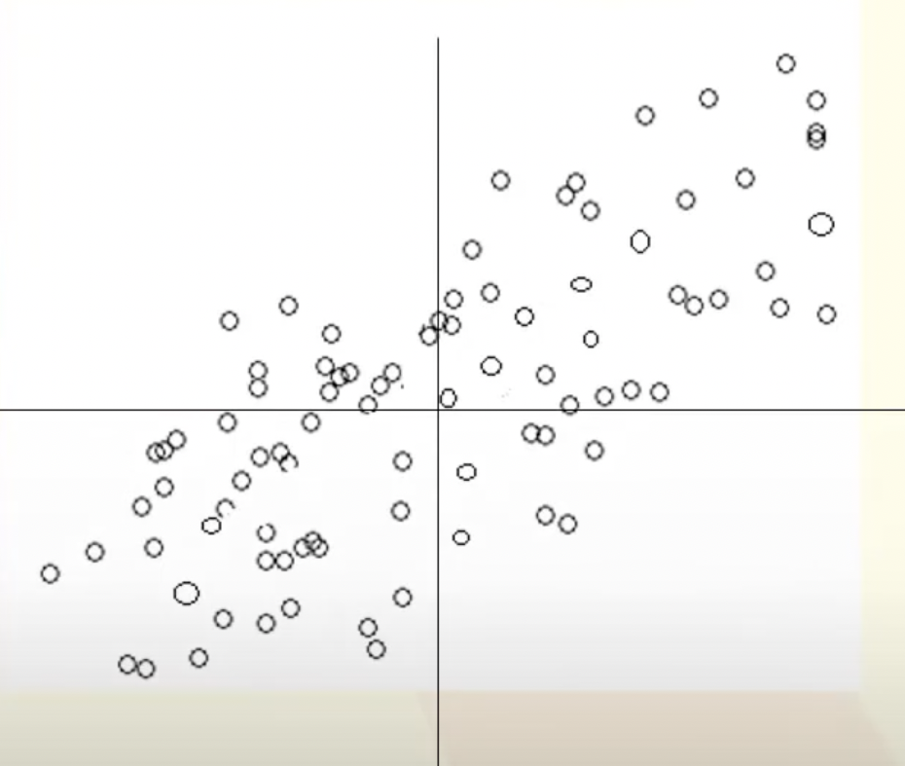
Step 4: Obtain Principle Component
After sorting the eigen values in desecnding order
Feature Vector V = has
been formulated
Egen vector corresponding to the highest eigen value will be the first PC in the direction of max variance
0.6779 | 0.7352
0.7321 | -0.6679

Slide 39
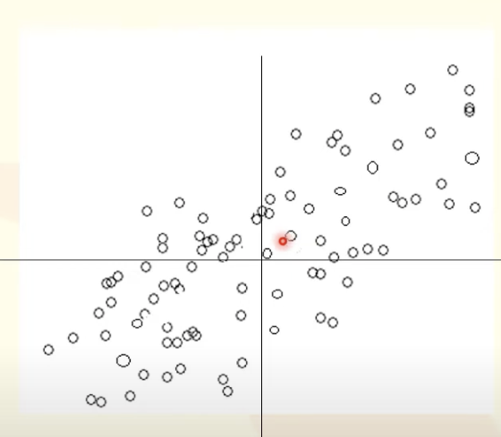
Step 4: Obtain Principle Component
After sorting the eigen values in desecnding order
Feature Vector V = has
been formulated
Egen vector corresponding to the highest eigen value will be the first PC in the direction of max variance
0.6779 | 0.7352
0.7321 | -0.6679

Slide 40
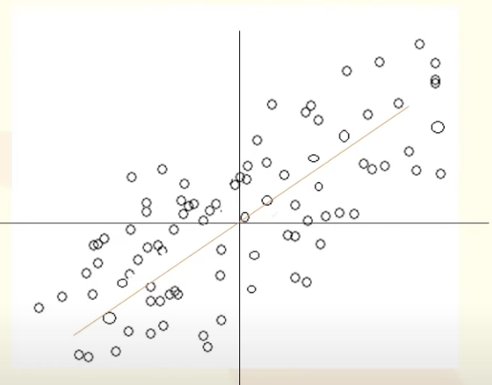
Step 4: Obtain Principle Component
After sorting the eigen values in desecnding order
Feature Vector V = has
been formulated
Egen vector corresponding to the highest eigen value will be the first PC in the direction of max variance
0.6779 | 0.7352
0.7321 | -0.6679

Slide 41
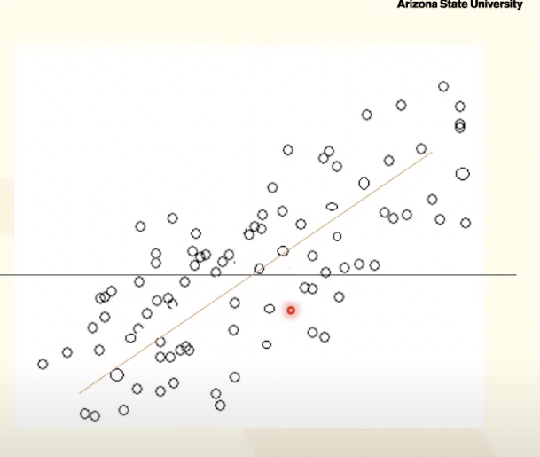
Step 4: Obtain Principle Component
After sorting the eigen values in desecnding order
Feature Vector V = has
been formulated
Egen vector corresponding to the highest eigen value will be the first PC in the direction of max variance
0.6779 | 0.7352
0.7321 | -0.6679

Slide 42
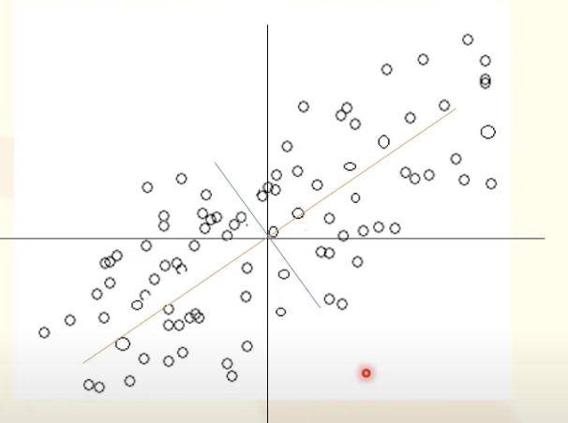
Step 4: Obtain Principle Component
After sorting the eigen values in desecnding order
Feature Vector V = has
been formulated
Egen vector corresponding to the highest eigen value will be the first PC in the direction of max variance
0.6779 | 0.7352
0.7321 | -0.6679

Slide 43
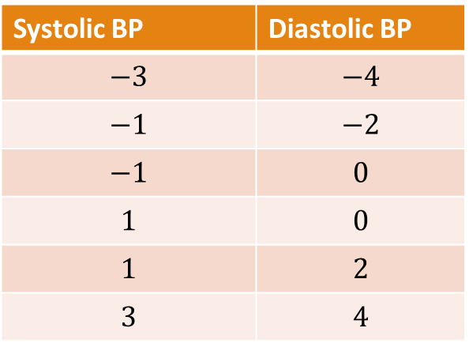

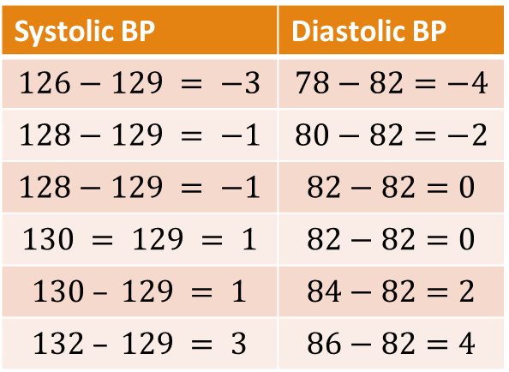

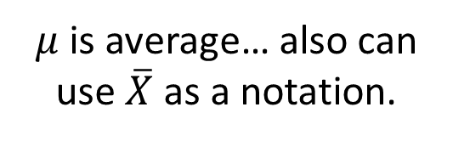
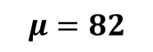
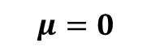
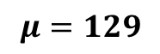

PCA: Step 1 – Center the data
Mean Center
Standardize
$$X_{new}=X−μ$$
$μ$ is average… also can use $\overline{X}$ as a notation.
$$X_{new}=\frac{X−μ}{σ}$$
Systolic BP | Diastolic BP
126 | 78
128 | 80
128 | 82
130 | 82
130 | 84
132 | 86
Systolic BP | Diastolic BP
$$126−129 = −3$$ | $$78−82=−4$$
$$128−129 = −1$$ | $$80−82=−2$$
$$128−129 = −1$$ | $$82−82=0$$
$$130 = 129 = 1$$ | $$82−82=0$$
$$130 – 129 = 1$$ | $$84−82=2$$
$$132 – 129 = 3$$ | $$86−82=4$$
Systolic BP | Diastolic BP
$$−3$$ | $$−4$$
$$−1$$ | $$−2$$
$$−1$$ | $$0$$
$$1$$ | $$0$$
$$1$$ | $$2$$
$$3$$ | $$4$$
$$μ=129$$
$$μ=82$$
$$μ=0$$
$$μ=0$$

Slide 44
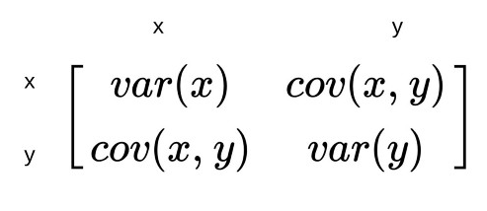


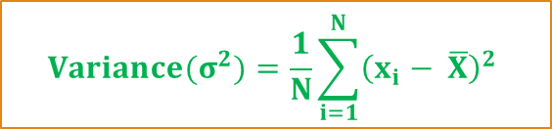
PCA: Step 2 – Compute Covariance
$${Variance(σ}^{2})=\frac{1}{N}\sum_{i=1}^{N}{{\left(x_{i}− \overline{X}\right)}^{2}}$$
Population Covariance
$$Cov\left(A,B\right)=\frac{\sum_{i=1}^{n}{\left(x_{i}− \overline{X}\right)×\left(y_{i}−\overline{Y}\right)}}{N}$$
Sample Covariance
Reduce This
Increase This
$$Cov\left(A,B\right)=\frac{\sum_{i=1}^{n}{\left(x_{i}− \overline{X}\right)×\left(y_{i}−\overline{Y}\right)}}{N−1}$$
Note: Variance is special case of covariance where two attributes are identical (covariance with itself)

Slide 45

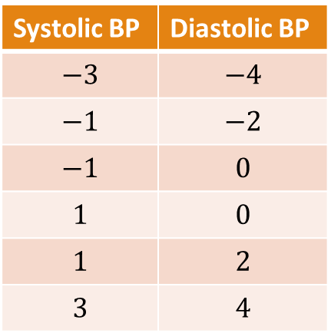




PCA: Step 2 – Compute Covariance
Systolic BP | Diastolic BP
$$−3$$ | $$−4$$
$$−1$$ | $$−2$$
$$−1$$ | $$0$$
$$1$$ | $$0$$
$$1$$ | $$2$$
$$3$$ | $$4$$
$${Variance(σ}^{2})=\frac{1}{N−1}\sum_{i=1}^{N}{{\left(x_{i}− \overline{X}\right)}^{2}}$$
$$Cov\left(A,B\right)=\frac{\sum_{i=1}^{n}{\left(x_{i}− \overline{X}\right)×\left(y_{i}−\overline{Y}\right)}}{N−1}$$
$$var(SBP)=\frac{{\left(−3−0\right)}^{2}+{\left(−1−0\right)}^{2}+{\left(−1−0\right)}^{2}+{\left(1−0\right)}^{2}+{\left(1−0\right)}^{2}+{\left(3−0\right)}^{2}}{5}$$
$$var\left(SBP\right)=\frac{9+1+1+1+1+9}{5}=\frac{22}{5}$$
$$var\left(SBP\right)=4.4$$
$$μ=0$$
$$μ=0$$
 | SBP | DBP
SBP
DBP
$$4.4$$

Slide 46



PCA: Step 2 – Compute Covariance
Systolic BP | Diastolic BP
$$−3$$ | $$−4$$
$$−1$$ | $$−2$$
$$−1$$ | $$0$$
$$1$$ | $$0$$
$$1$$ | $$2$$
$$3$$ | $$4$$
$${Variance(σ}^{2})=\frac{1}{N−1}\sum_{i=1}^{N}{{\left(x_{i}− \overline{X}\right)}^{2}}$$
$$Cov\left(A,B\right)=\frac{\sum_{i=1}^{n}{\left(x_{i}− \overline{X}\right)×\left(y_{i}−\overline{Y}\right)}}{N−1}$$
$$var(SBP, DBP)=\frac{\left(−3×−4\right)+\left(−1×−2\right)+\left(−1×0\right)+\left(1×0\right)+\left(1×2\right)+(3×4)}{5}$$
$$var\left(SBP, DBP\right)=\frac{12+2+0+0+2+12}{5}=\frac{28}{5}$$
$$var\left(SBP, DBP\right)=5.5$$
$$μ=0$$
$$μ=0$$
 | SBP | DBP
SBP
DBP
$$4.4$$
$$5.6$$
$$5.6$$
$$8.0$$
b. vbnvbnv

Slide 47

PCA: Step 2 – Compute Eigen Values
⋋1 = 12.08 ⋋2 = 0.32

Slide 48



PCA: Step 3 – Compute Eigen Vectors
Normalize

Slide 49

PCA: Step 4 – Order Eigen Vectors

Slide 50


PCA: Step 3 and 4 – Eigenvalues and Eigenvectors
Systolic BP | Diastolic BP
$$−3$$ | $$−4$$
$$−1$$ | $$−2$$
$$−1$$ | $$0$$
$$1$$ | $$0$$
$$1$$ | $$2$$
$$3$$ | $$4$$
$$×$$
0.59 | -0.81
0.81 | 0.59
$$=$$
How to get these eigen vectors?
 | SBP | DBP
SBP
DBP
$$4.4$$
$$5.6$$
$$5.6$$
$$8.0$$

Slide 51






PCA: Step 5 – Compute Principal Components
Systolic BP | Diastolic BP
$$−3$$ | $$−4$$
$$−1$$ | $$−2$$
$$−1$$ | $$0$$
$$1$$ | $$0$$
$$1$$ | $$2$$
$$3$$ | $$4$$
PC1 | PC2
$$−5.0$$ | $$0.1$$
$$−2.2$$ | $$−0.4$$
$$−0.6$$ | $$0.8$$
$$0.6$$ | $$−0.8$$
$$2.2$$ | $$0.4$$
$$5.0$$ | $$−0.1$$
Transformed Data (or Principal Components)
$$×$$
0.59 | -0.81
0.81 | 0.59
$$=$$
How to get these eigen vectors?
 | PC1 | PC2
PC1
PC2
 | SBP | DBP
SBP
DBP
$$12.08$$
$$0$$
$$4.4$$
$$5.6$$
$$0$$
$$0.32$$
$$5.6$$
$$8.0$$
$$Percentage Variance of PC1=\frac{12.08}{12.08+.0.32}=97.41\%$$

Slide 52
PCA: Reduce Dimensions
Systolic BP | Diastolic BP
$$−3$$ | $$−4$$
$$−1$$ | $$−2$$
$$−1$$ | $$0$$
$$1$$ | $$0$$
$$1$$ | $$2$$
$$3$$ | $$4$$
PC1 | PC2
$$−5.0$$ | $$0.1$$
$$−2.2$$ | $$−0.4$$
$$−0.6$$ | $$0.8$$
$$0.6$$ | $$−0.8$$
$$2.2$$ | $$0.4$$
$$5.0$$ | $$−0.1$$
Transformed Data (or Principal Components)
$$×$$
0.59 | -0.81
0.81 | 0.59
$$=$$
How to get these eigen vectors?
 | PC1 | PC2
PC1
PC2
 | SBP | DBP
SBP
DBP
$$12.08$$
$$0$$
$$4.4$$
$$5.6$$
$$0$$
$$0.32$$
$$5.6$$
$$8.0$$
$$Percentage Variance of PC1=\frac{12.08}{12.08+.0.32}=97.41\%$$

Slide 53
PCA in Python

Slide 54

PCA Example via Python Code

Slide 55

PCA Example via Python Code

Slide 56

PCA Example via Python Code

Slide 57

PCA Example via Python Code

Slide 58

PCA Example via Python Code

Slide 59
Self Study
https://builtin.com/data-science/step-step-explanation-principal-component-analysis
https://towardsdatascience.com/the-mathematics-behind-principal-component-analysis-fff2d7f4b643
https://www.projectrhea.org/rhea/index.php/PCA_Theory_Examples
https://www.youtube.com/watch?v=_UVHneBUBW0&ab_channel=StatQuestwithJoshStarmer
https://youtu.be/FgakZw6K1QQ?list=PLUE9cBml08ygE5rkN42FanwMiNMNFzh5N

